Slide 1

Command Line Basics 2/2
Linux Essentials
Session-3

Slide 2
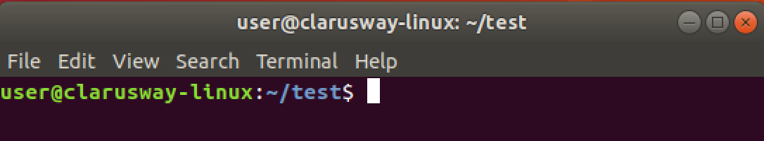
Command Prompt
User Name
Host Name
Current Directory
User Type
$ normal user
# Privileged user
Notes:
When we look deeply at the command prompt we see some details about our environment. For example, here, user refers to the current logged on user. And host name is generally the machine being used. Then, the current directory, where the user is working on and lastly user type,
which is a $ sign means the current user is a normal user without extra privilages.

Slide 3
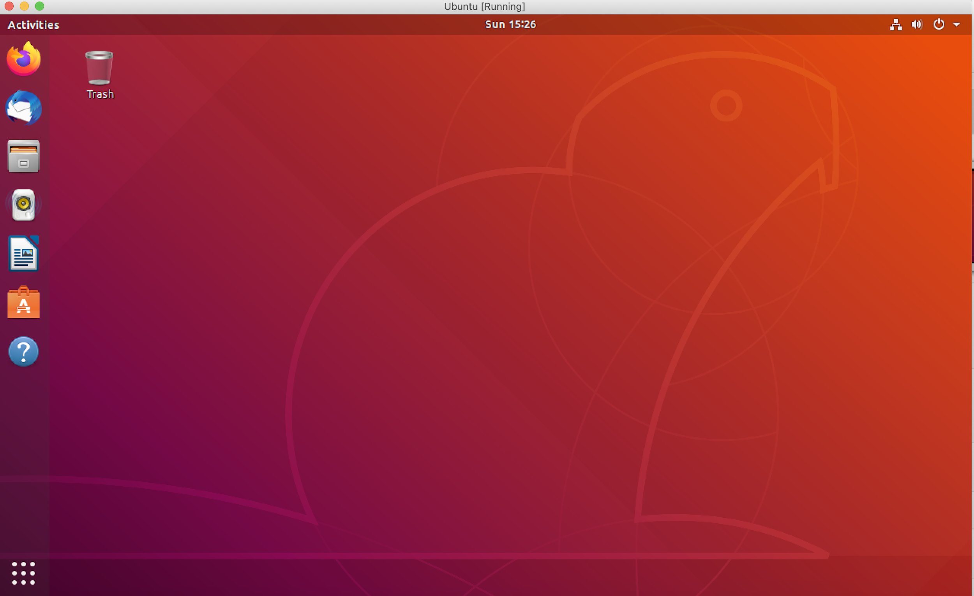
GUI

Slide 4
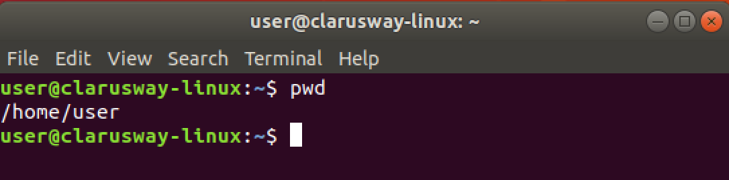
Basic Shell Commands
pwd show current path
Notes:
Though you can see the current path on your command prompt, the most used command, in my opinion, is pwd.
It is my habit to look and confirm my working directory by using this command. Especially if you are the root user, it becomes more important to know where you are on the system. I do also suggest you use this command first ..
Let’s do it together please...

Slide 5
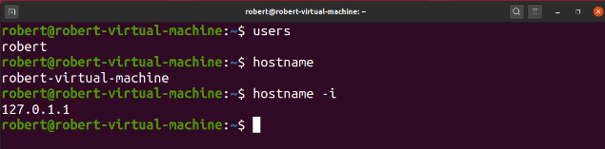
Basic Shell Commands
whoami current user
hostname shows the system hostname
hostname -i Show the IP address of the system

Slide 6
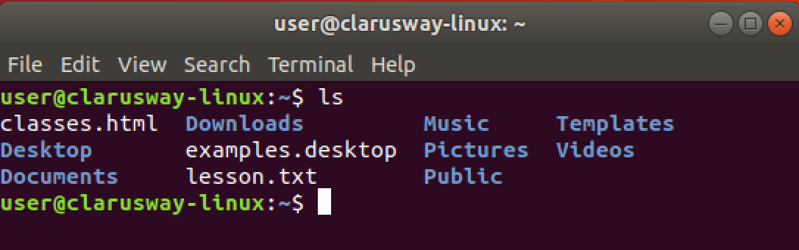
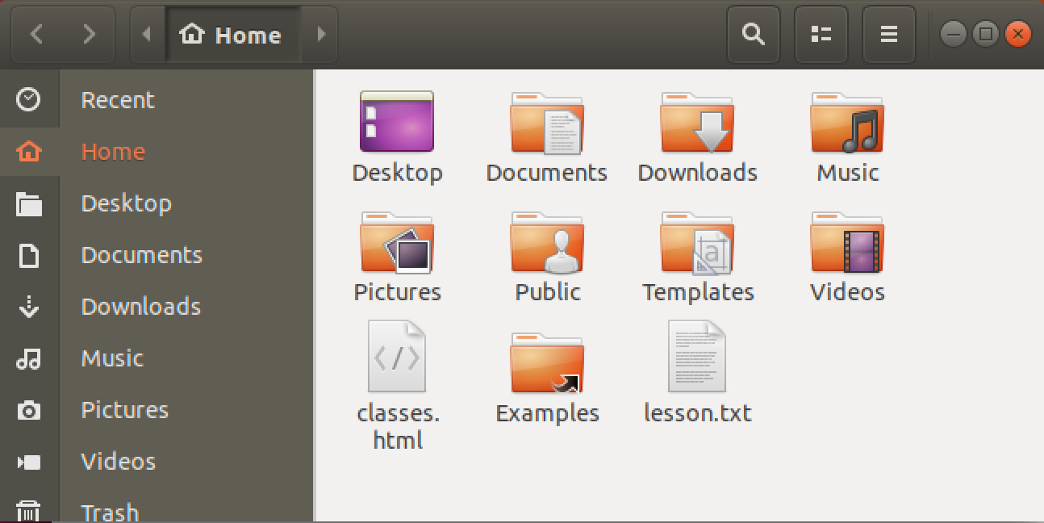
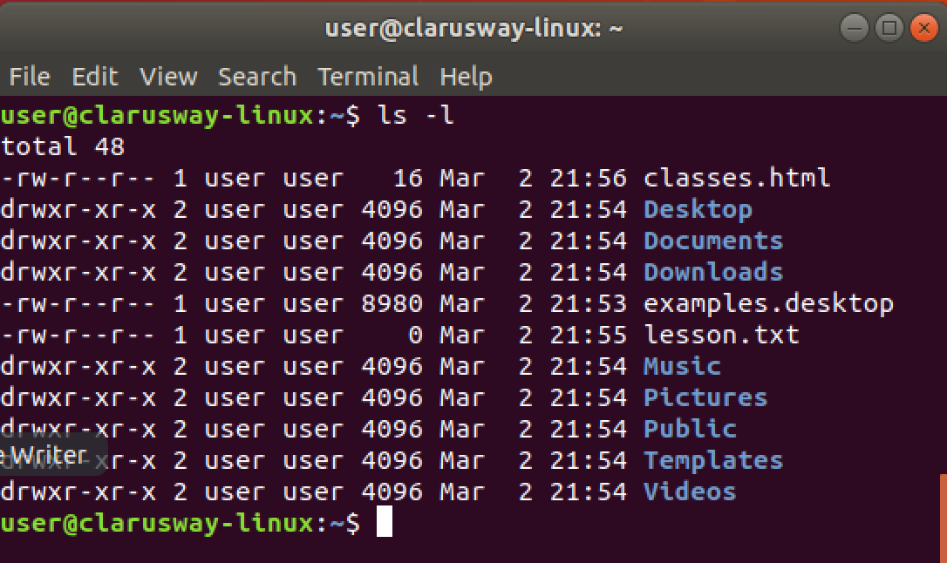
Basic Shell Commands
ls lists directory contents
ls -l lists directory contents with details
ls -al lists all the contents with hidden ones
Notes:
ls, means list directory contents, is the most used command with pwd in Linux, I think.
It has many arguments, I mean options.
ls -l, ls -a, and ls -al are mostly used options for ls command. it should be space between options and command
Let’s check the contents of our current directories with different arguments.

Slide 7
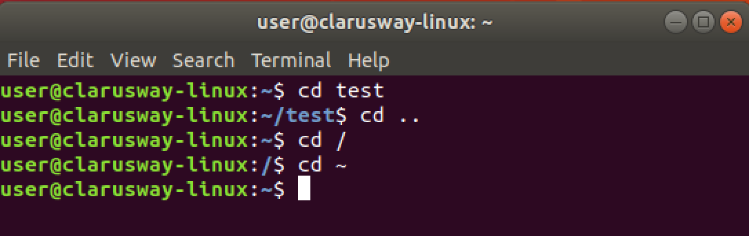
Basic Shell Commands
cd [dir] change (current) directory
cd .. change current directory to one level up
cd / change current directory to the root directory
cd ~ change current directory to the home directory

Slide 8
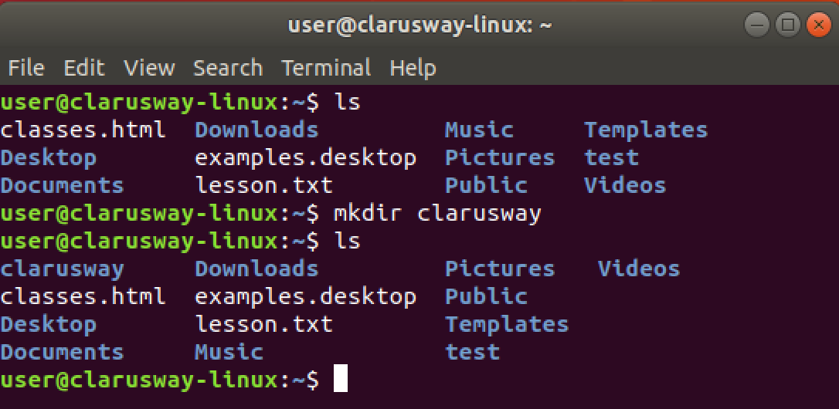
Basic Shell Commands
mkdir [dir] create a new directory

Slide 9
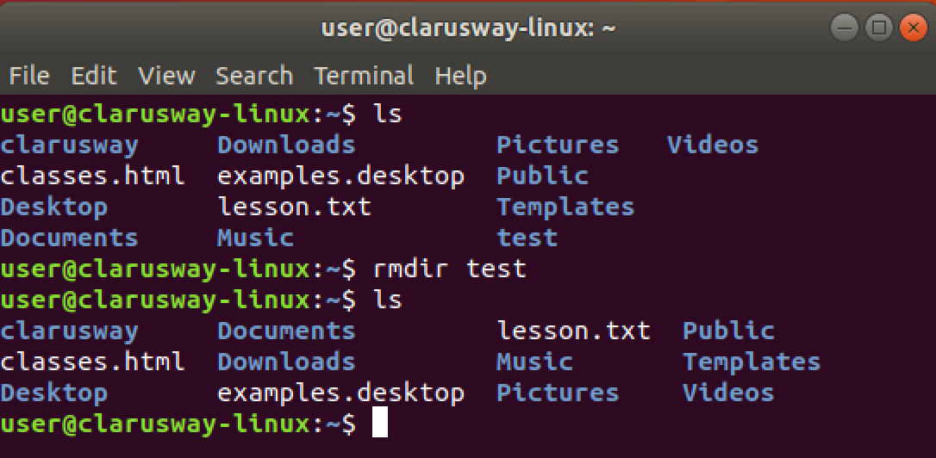
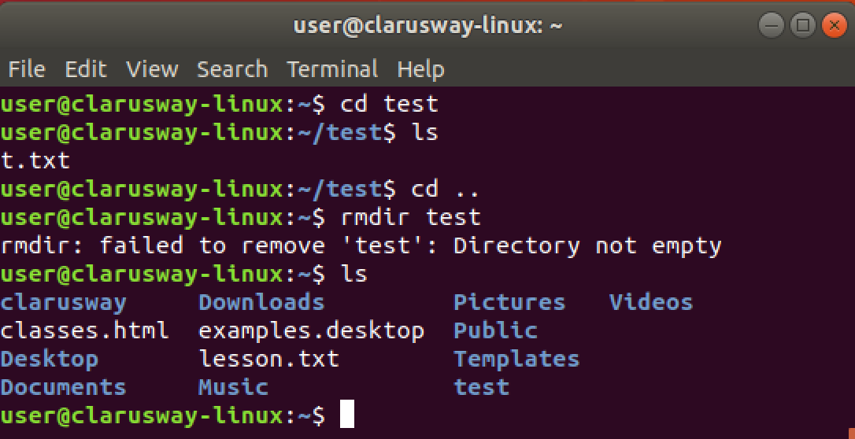
Basic Shell Commands
rmdir [dir] delete an empty directory

Slide 10
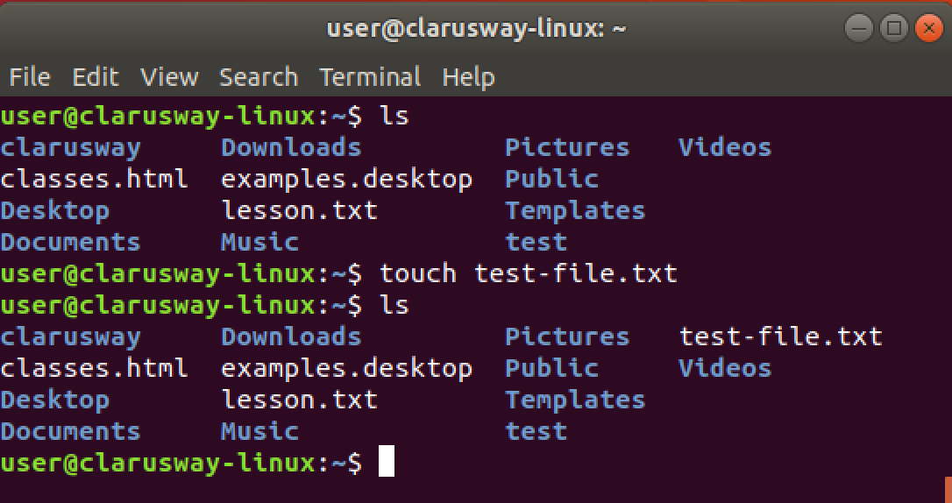
Basic Shell Commands
touch create a file
echo create a file and write string inside
cat >
Notes:
to create an em

Slide 11
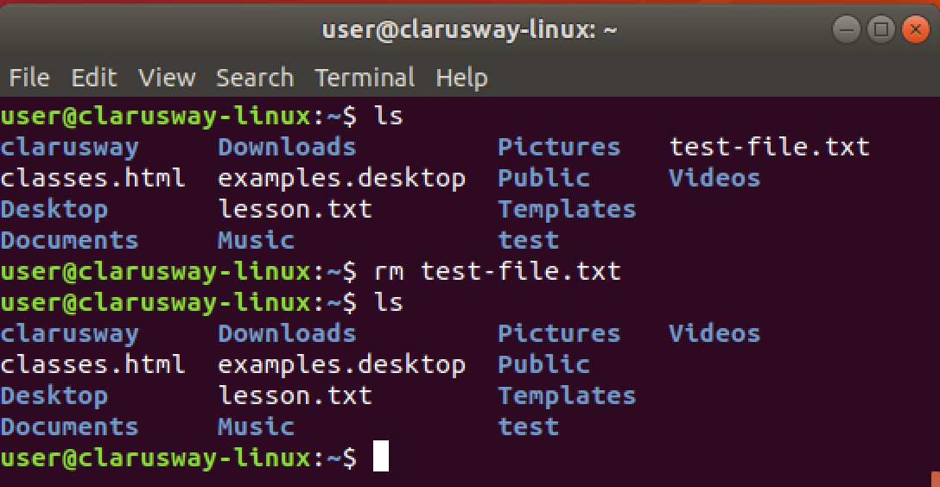
Basic Shell Commands
rm delete a file

Slide 12
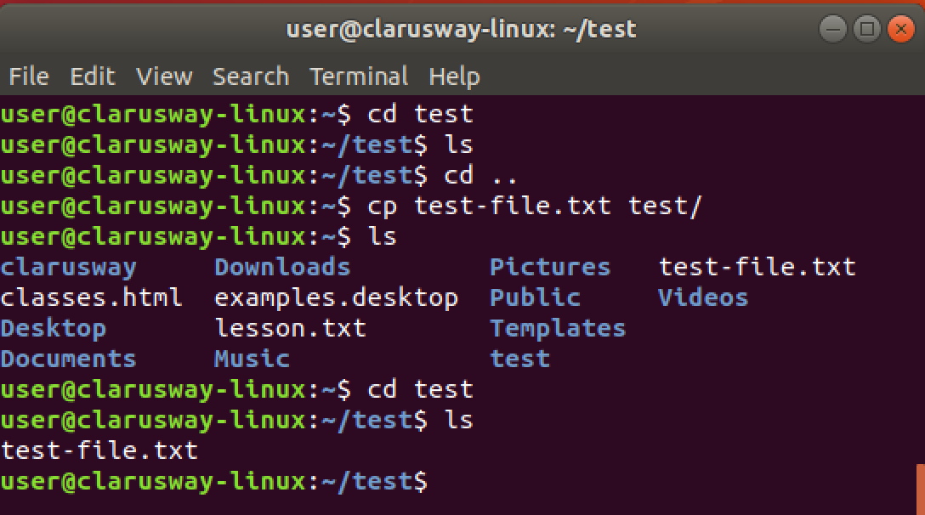
Basic Shell Commands
cp copy a file to another location

Slide 13
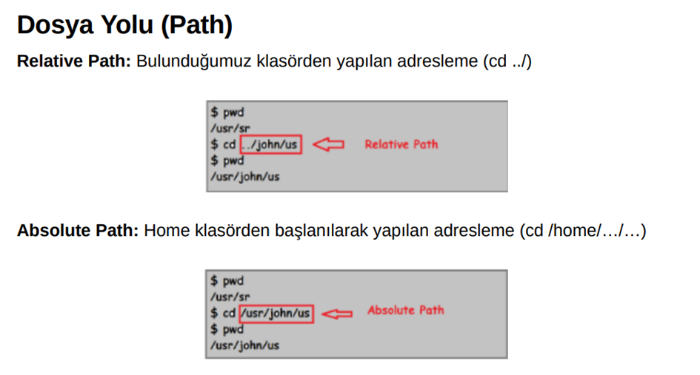

Slide 14
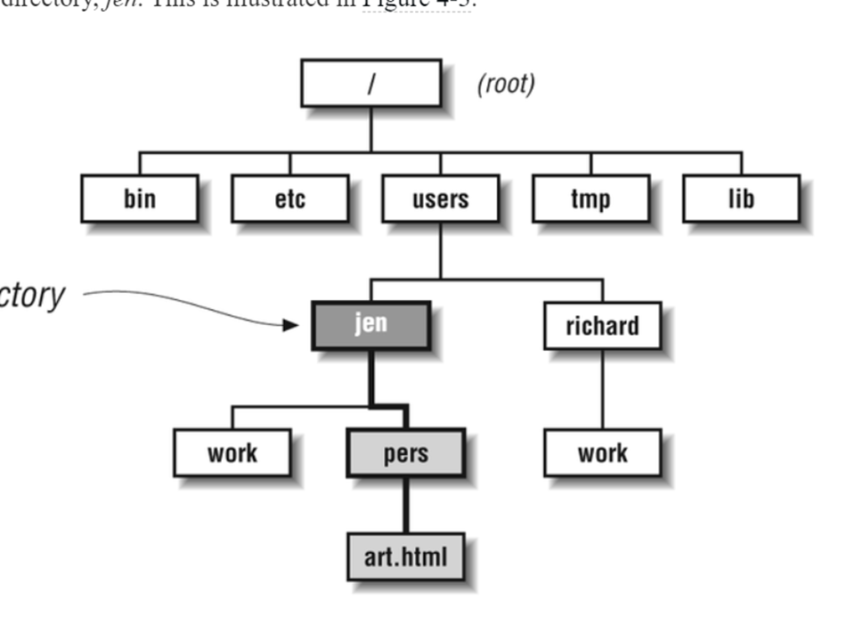

Slide 15
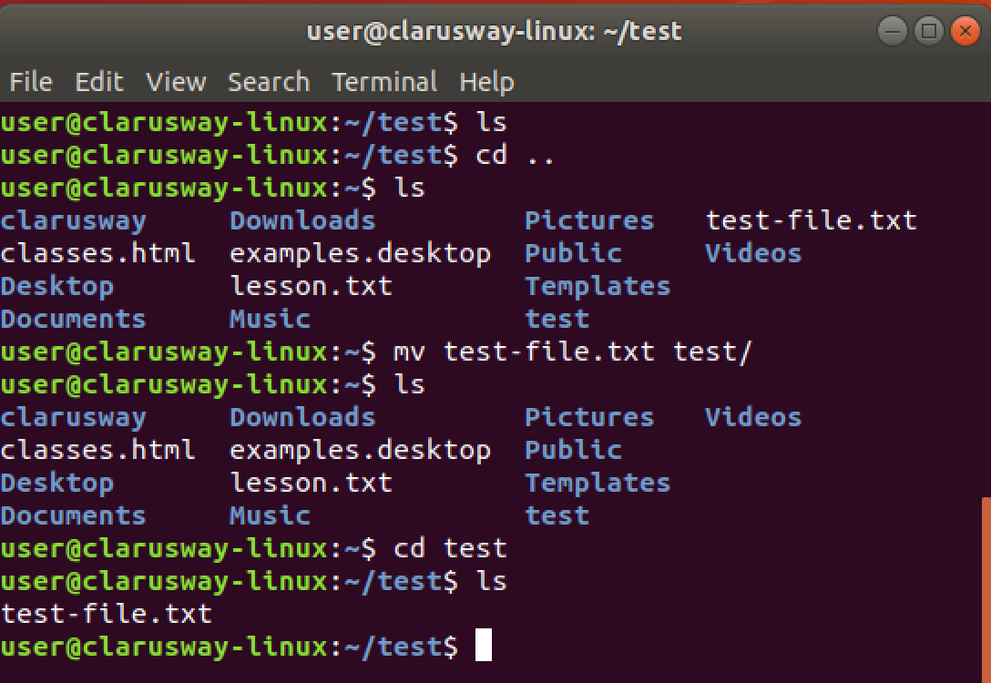
Basic Shell Commands
mv move a file to another location
renaming the file

Slide 16
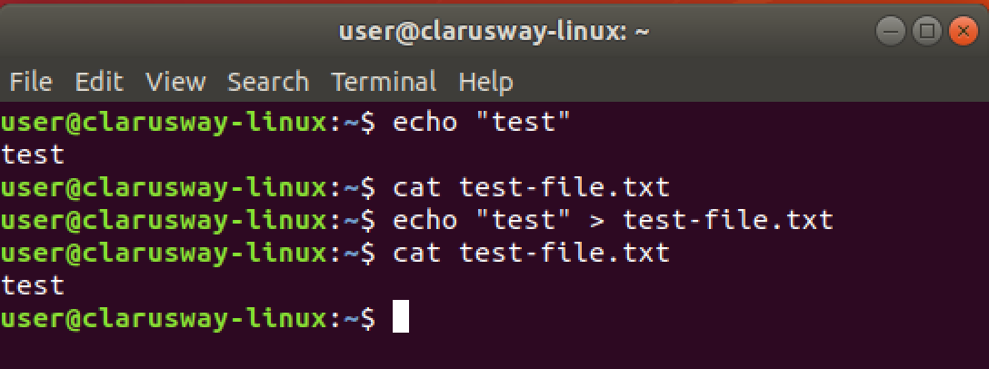
Basic Shell Commands
echo print message to screen
echo > [file] print message into a file

Slide 17
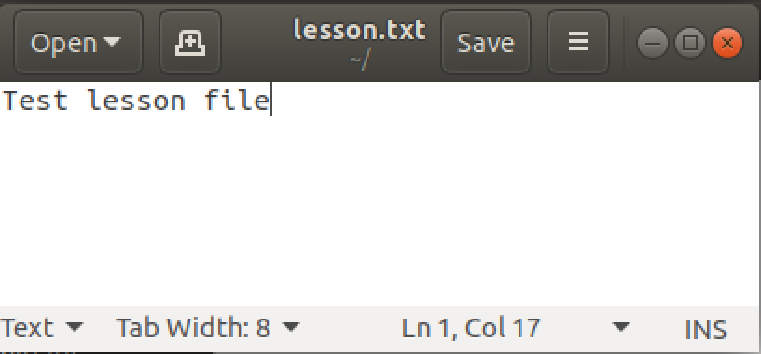
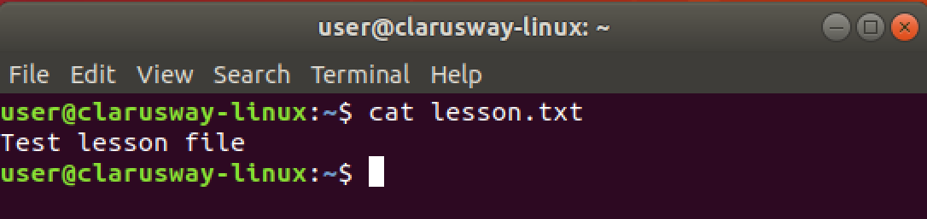
Basic Shell Commands
cat show file contents
Notes:
more

Slide 18
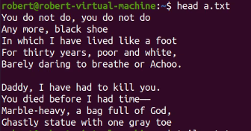
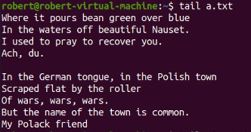
Basic Shell Commands
head show first 10 lines from file contents
tail show last 10 lines from file contents
Notes:
more
https://literarydevices.net/to-my-mother/
Because I feel that, in the Heavens above,
The angels, whispering to one another,
Can find, among their burning terms of love,
None so devotional as that of “Mother,”
Therefore by that dear name I long have called you—
You who are more than mother unto me,
And fill my heart of hearts, where Death installed you
In setting my Virginia’s spirit free.
My mother—my own mother, who died early,
Was but the mother of myself; but you
Are mother to the one I loved so dearly,
And thus are dearer than the mother I knew
By that infinity with which my wife
Was dearer to my soul than its soul-life.

Slide 19

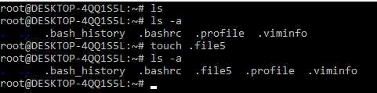
Hidden Files and Directories
Any file or directory starts with period (.)
.abc
Hidden files may be listed via ls using the -a option, to show all files.
Notes:
Hidden files in Linux are the files that are not listed when the user runs ls command. The name of a hidden file starts with a. dot(.) In Linux, not only files, but directories can be hidden as well. Files are hidden in Linux for many reasons. One of them is to make sure that users don’t accidentally modify the contents of these files. Another could be to prevent the accidental deletion of these files. On shared systems files could be hidden for privacy issues.

Slide 20

Kahoot!
Notes:
PATHS

Slide 21
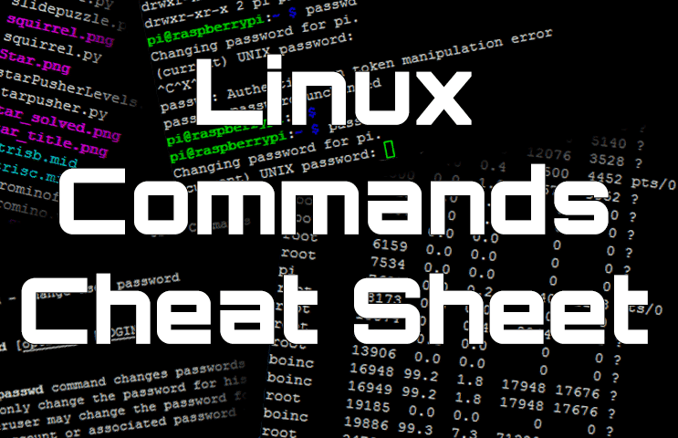
Basic SHELL Commands

Slide 22
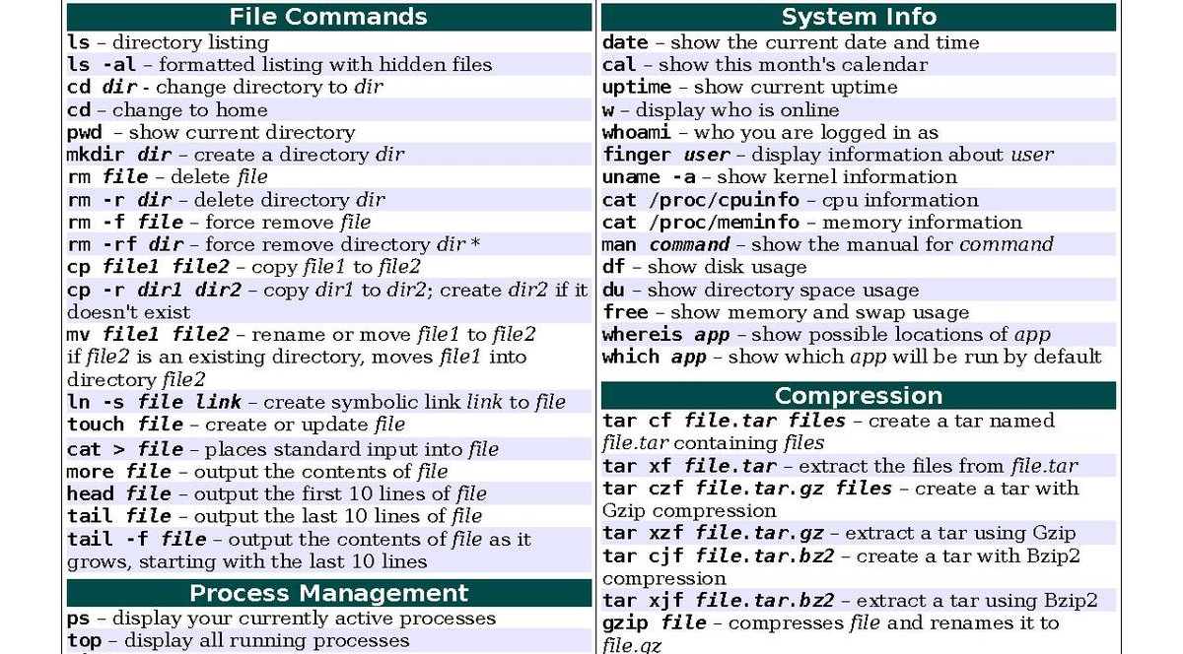
Basic SHELL Commands

Slide 23
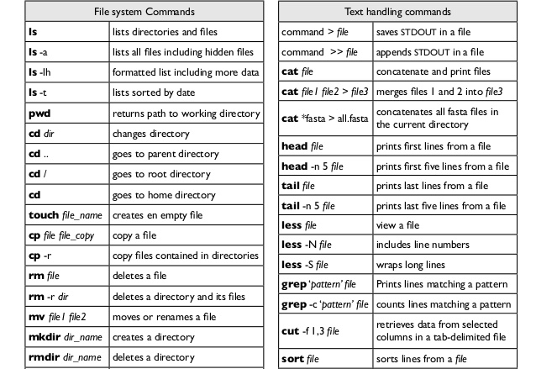
Basic SHELL Commands

Slide 24
Using the Command Line to Get Help
Notes:
For this purposes there are many ways, I just want to show 2 of them respectively ..

Slide 25
Table of Contents
Man Pages
Info Pages

Slide 26
Man Pages
1

Slide 27

Man Pages
man [command]
A man page (short for manual page) is a form of software documentation usually found on a Unix or Unix-like operating system.
if we install a package to do some task, the man Page for that package will typically be installed at the same time. This gives us the ability to take a look at that documentation and make sure that we're using it in a manner consistent with its design.
The man page for a particular command is invoked by preceding the command with man.

Slide 28
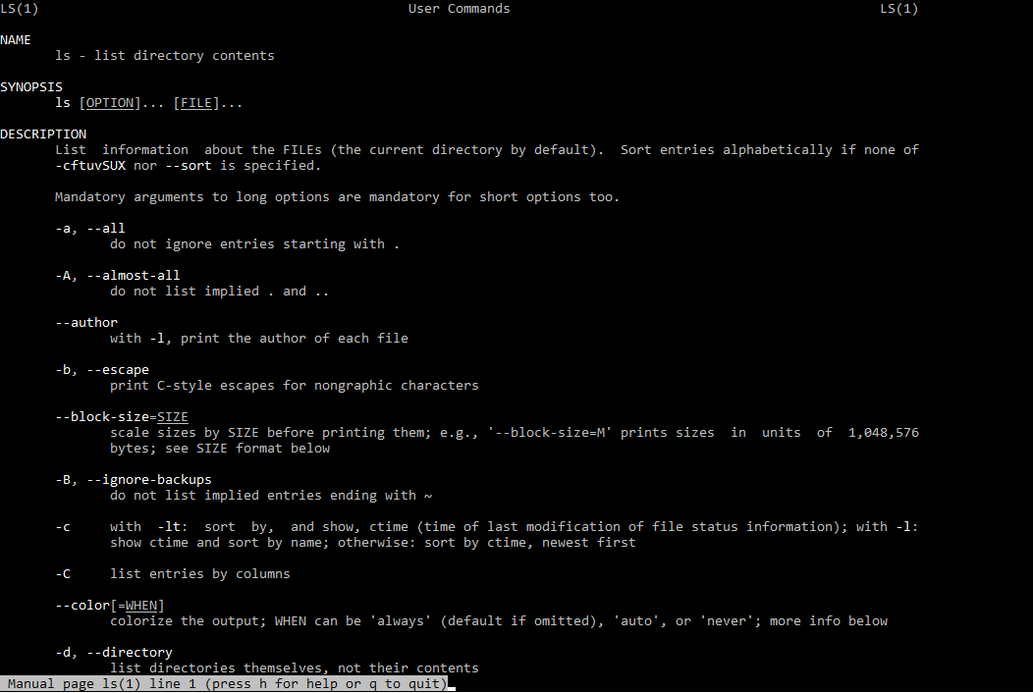
Man Pages
man ls
NAME
Program or Function name(s) followed by descriptions of functionality.
SYNOPSIS
A short overview of available options
DESCRIPTION
Detailed information about arguments and options.
Notes:
NAME
Program or Function name(s) followed by descriptions of functionality.
SYNOPSIS
A short overview of available options
DESCRIPTION
Detailed information about arguments and options.

Slide 29
Info Pages
2

Slide 30
Info Pages
info [command]
Info pages are additional documentation with more robust capability in detail. Info Page normally provides more detailed information about a command than its respective man page. Additionally, Info uses a structure for linking these pages together, and they may be assembled into a larger collection.
The info page for a particular command is invoked by preceding the command with info

Slide 31
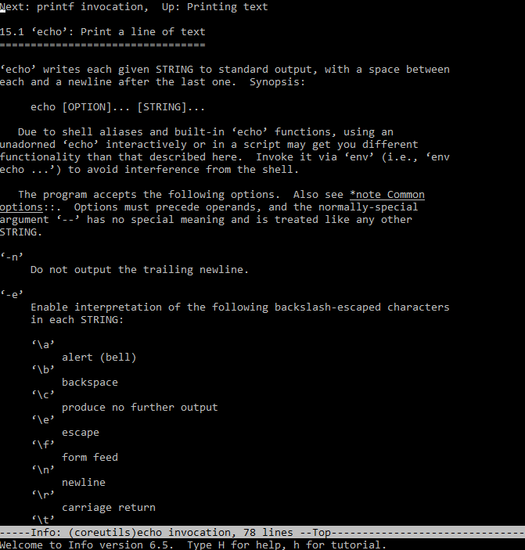
Info Pages
info echo

Slide 32
Simple Globbing
Globbing is primarily used to match patterns in filenames or text by using a wildcard character to create a pattern.
Character | Name | Function
? | Question mark | Match any single character
* | Asterisk | Match any number of character(s)
[] | Brackets | Match character from a range
^ | Caret | Used to match starting character
$ | Dollar sign | Used to match ending character
{} | Curly brace | Used to match more than one pattern
| | Pipe | Used for applying more than one condition
Notes:
File globbing is a feature provided by the UNIX/Linux shell to represent multiple filenames by using special characters called wildcards with a single file name. A wildcard is essentially a symbol which may be used to substitute for one or more characters.

Slide 33
THANKS!
Any questions?

